Slide 1

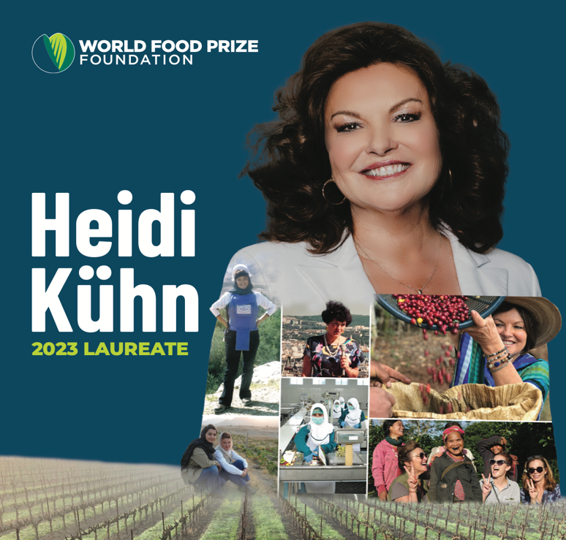
Laureate lessons
2023: Heidi Kühn
Winner of the 2023 World Food Prize for restoring agriculture to de-mined land in former war zones
©Greetje Kranenburg, Stimuleer - in cooperation with Wageningen Youth Institute

Slide 2
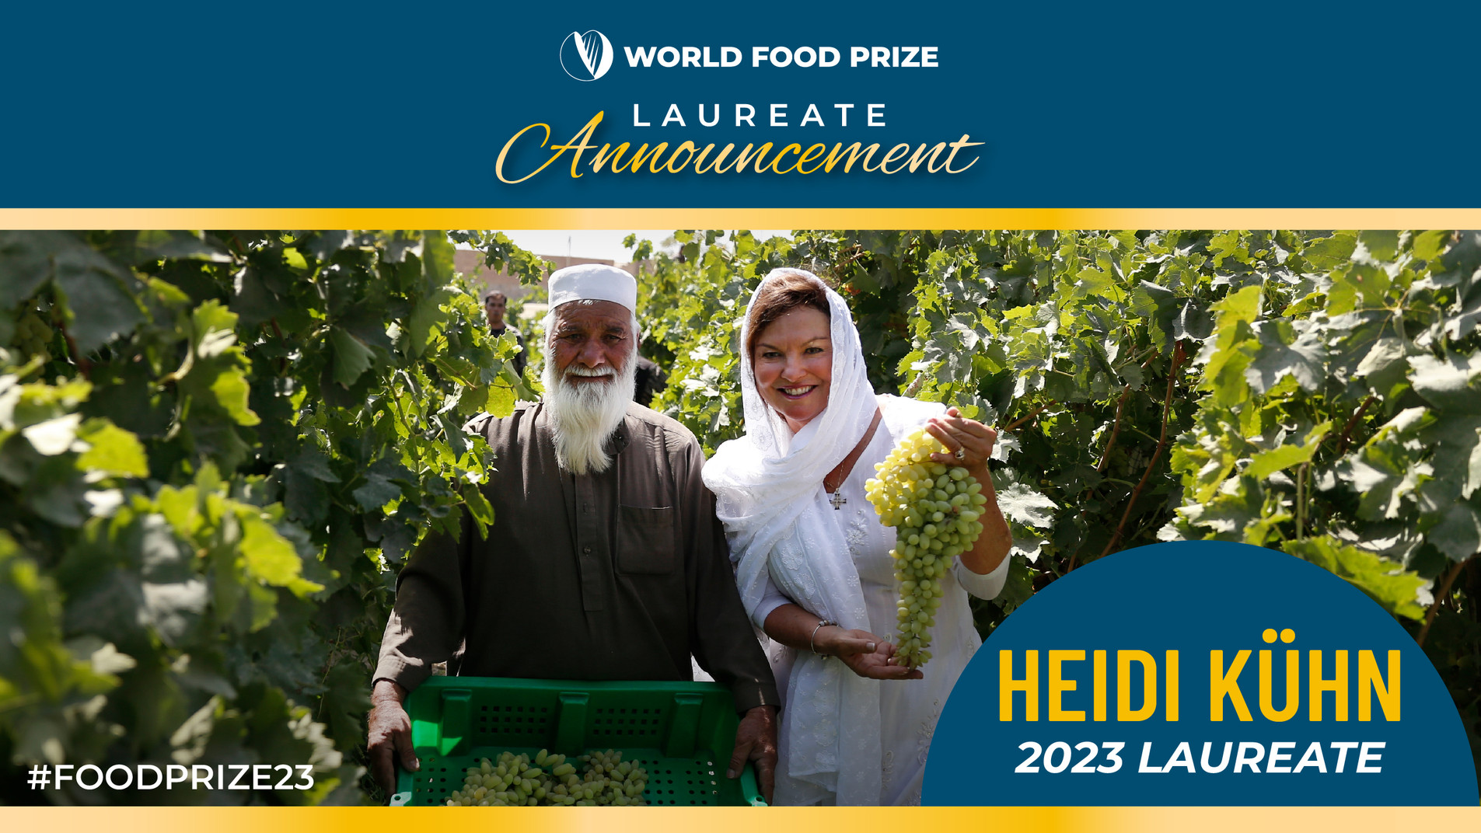

Slide 3
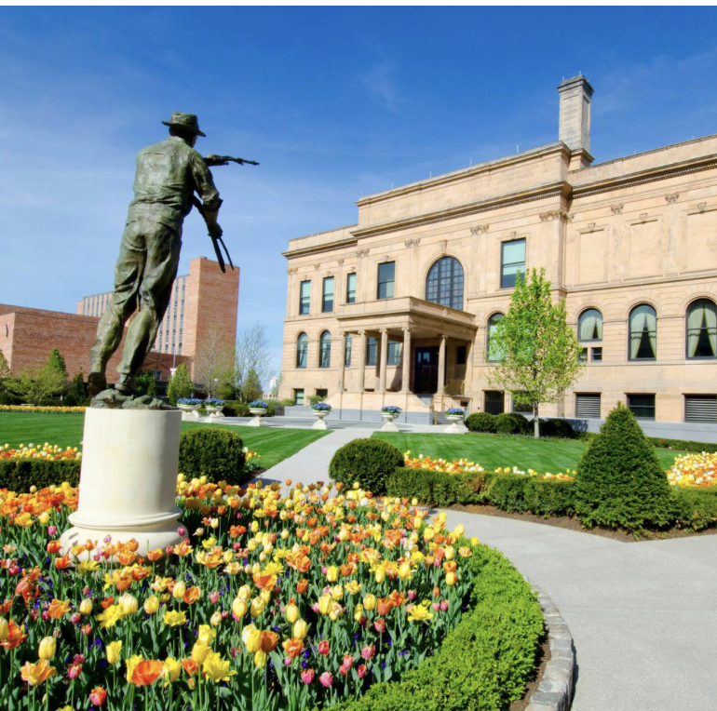

What is the World Food Prize?
International award recognizing individuals who have advanced human development by improving the quality, quantity, or availability of food in the world
“Nobel Prize for food and agriculture”
Founded in 1986 by Dr. Norman E. Borlaug, recipient of the 1970 Nobel Peace Prize
Notes:
The World Food Prize
The World Food Prize is the foremost international award recognizing the achievements of individuals who have advanced human development by improving the quality, quantity or availability of food in the world. The Prize was founded in 1986 by Dr. Norman E. Borlaug, recipient of the 1970 Nobel Peace Prize. Since then, the World Food Prize has honored more than 50 outstanding individuals who have made vital contributions throughout the world. The World Food Prize annually hosts the Borlaug Dialogue international symposium and a variety of youth education programs to help further the discussion on cutting-edge global food security issues and inspire the next generation to end hunger.

Slide 4
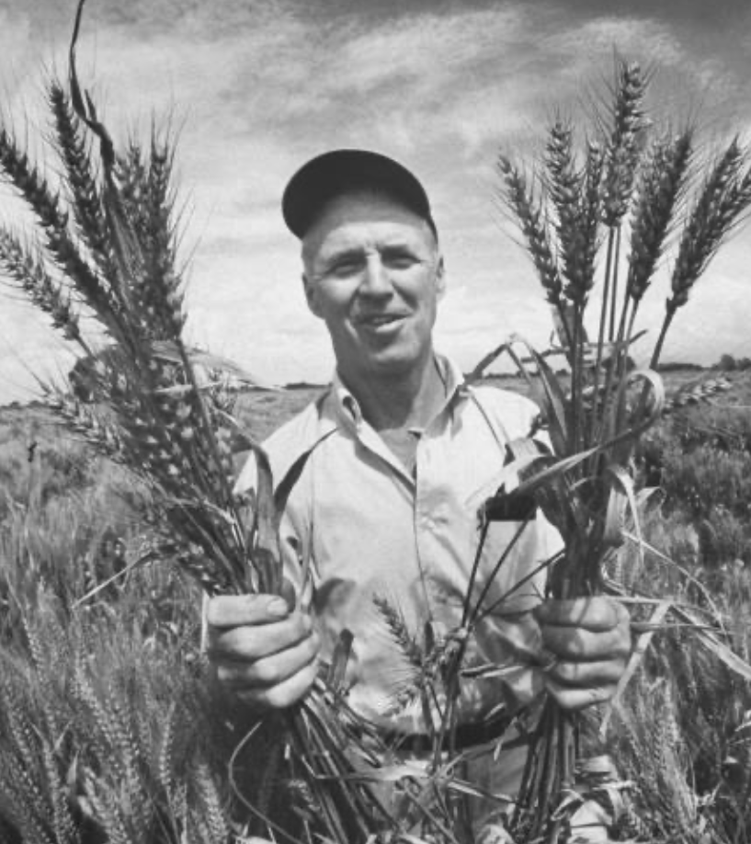
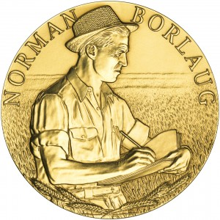
Norman Borlaug
American agricultural scientist
“Father” of the Green Revolution
Introduction of new varieties of crops with higher yields and less diseases
Impact: significant reduction in world hunger
1970: Nobel Peace Prize
Notes:
The World Food Prize
The World Food Prize is the foremost international award recognizing the achievements of individuals who have advanced human development by improving the quality, quantity or availability of food in the world. The Prize was founded in 1986 by Dr. Norman E. Borlaug, recipient of the 1970 Nobel Peace Prize. Since then, the World Food Prize has honored more than 50 outstanding individuals who have made vital contributions throughout the world. The World Food Prize annually hosts the Borlaug Dialogue international symposium and a variety of youth education programs to help further the discussion on cutting-edge global food security issues and inspire the next generation to end hunger.

Slide 5
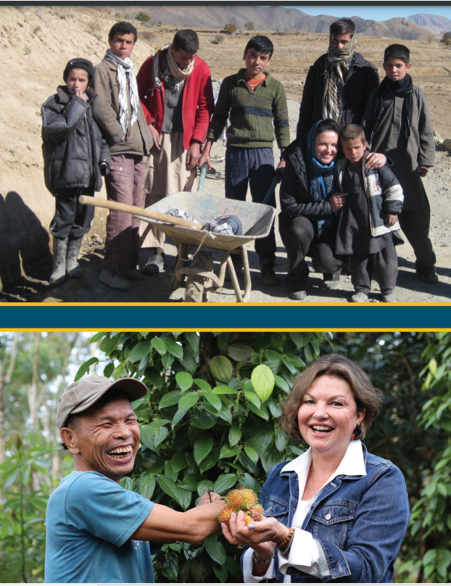
Grounds for WFP Heidi Kühn
Heidi Kühn of the United States received the 2023 World Food Prize for her farmer-focused development model that revitalizes farmland, food security, livelihoods and resilience after devastating conflict. For more than two decades, she has shown more than a million people living in war-torn regions around the world a way forward for restoring peace and prosperity through agriculture.

Slide 6


Slide 7
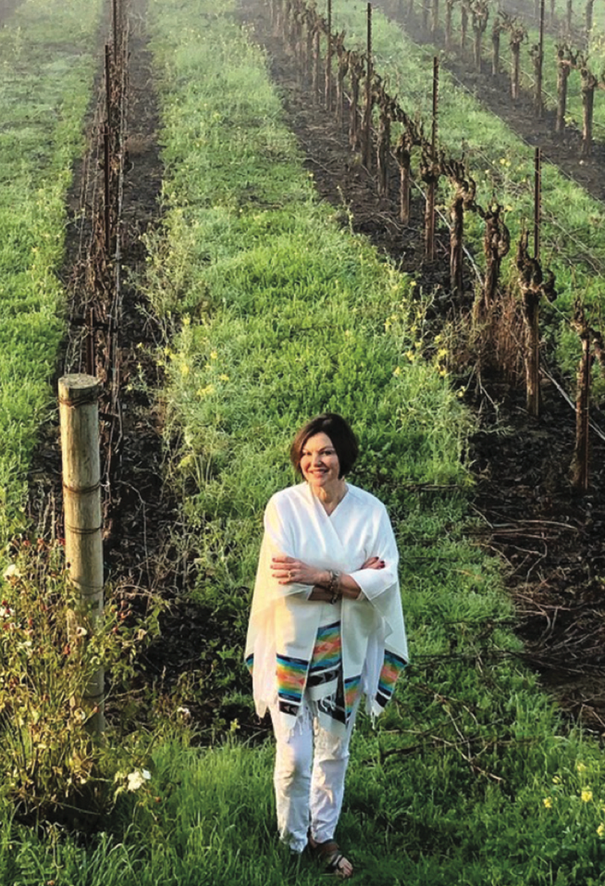
Life and career of Heidi Kühn
Born in California
Degree in Political Economics (1970)
Founder and owner of Newslink International (Juneau, Alaska)
First US reporter in eastern part of Sovjet Union
Battle with cancer
Founder of Roots of Peace (1997)
Notes:
Life and career of Heidi Kühn
Heidi Kühn, a fifth-generation Californian, has a rich history of activism and entrepreneurship. Her journey began with a degree in Political Economics from the University of California, Berkeley, where her involvement in the peace movement of the 1970s left a profound impact on her. It was during this time that she met her husband, Gary.
Heidi Kühn's career took an unexpected turn when she founded and owned NewsLink International, a television news company based in Juneau, Alaska. Through her reporting for major networks, she covered significant events such as the Exxon Valdez oil spill and played a role in thawing relations between the U.S. and the Soviet Union. Notably, as the first U.S. reporter to venture into the eastern region of the Soviet Union, her focus on peace-building efforts between the superpowers highlighted her commitment to promoting understanding and reconciliation.
However, Heidi Kühn's journalistic career was interrupted by a personal battle with cancer. After winning her own fight against cancer, Heidi Kühn was inspired to found the nonprofit organization Roots of Peace to battle an insidious “cancer of the earth” — by replacing the remnants of war with bountiful farmland.

Slide 8
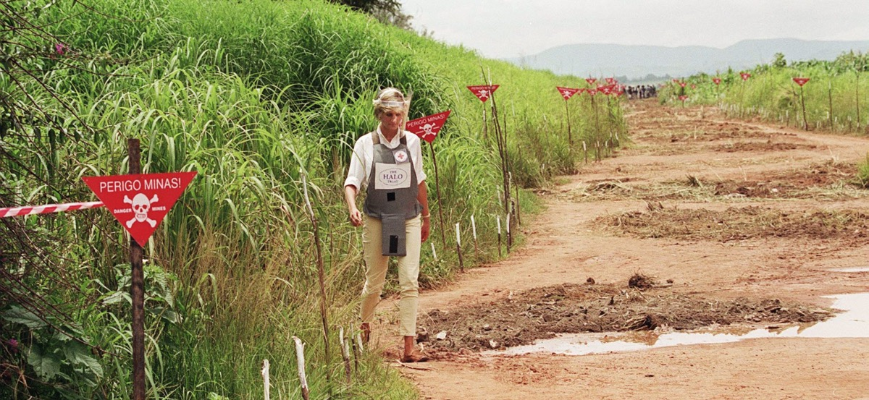

Founding Roots of Peace
It started in 1997
Inspired by Princess Diana
Mission to transform former war zones into agricultural lands

Slide 9
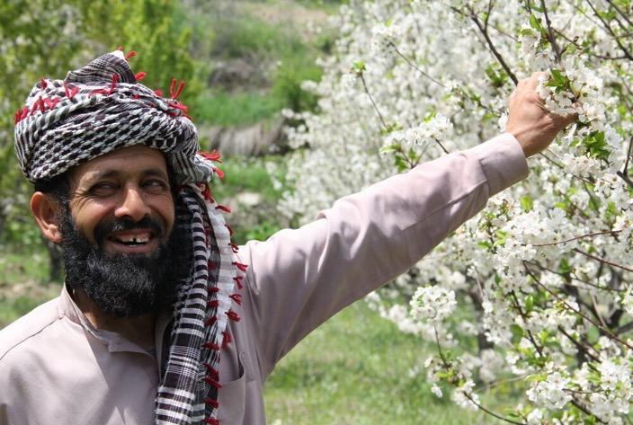
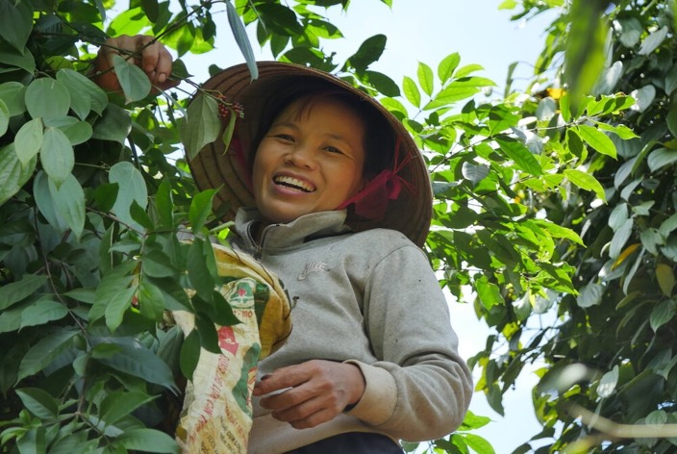
Roots of Peace
Since the start the work has impacted one million farmers
Afghanistan, Angola, Azerbaijan, Bosnia-Herzegovina, Cambodia, Croatia, Guatemala, Iraq, Israel, Palestinian areas and Vietnam
Notes:
Roots of Peace
Since 1997, the work of Roots of Peace has impacted over one million farmers and members of farming families, spanning Afghanistan, Angola, Azerbaijan, Bosnia-Herzegovina, Cambodia, Croatia, Guatemala, Iraq, Israel, Palestinian areas and Vietnam. The organization focuses on clearing landmines from agricultural land and rehabilitating the soil so that farmers can safely cultivate crops and rebuild their livelihoods

Slide 10
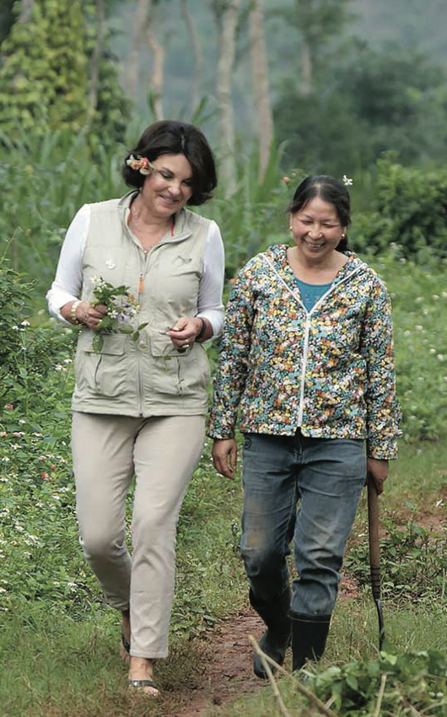
Turning “mines to vines”
Removing mines from field areas and irrigation canals
Re-establish agricultural activity with high value crops like grapes, black pepper, fruit trees, lavender, etc.
Intercropping compatible crops like cacao and cashew
Used modern methods like off-ground trellising
Developing value chains including processing facilities
Notes:
Turning “mines to vines”
The primary goal of Roots of Peace is to address the global issues of landmines and agricultural landmines in conflict-affected regions. The organization aims to achieve this goal through several key objectives:
Landmine Clearance: Roots of Peace works to clear landmines and unexploded ordnance from agricultural land, making it safe for farming and other productive activities.
Agricultural Rehabilitation: The organization focuses on rehabilitating the soil and implementing sustainable agriculture practices in areas affected by landmines. This includes providing training, resources, and support to farmers to help them cultivate crops and rebuild their livelihoods.
Economic Development: By clearing landmines and promoting agricultural development, Roots of Peace aims to stimulate economic growth in conflict-affected communities. This includes creating employment opportunities, increasing food security, and fostering local market development.
Peacebuilding: Roots of Peace believes that promoting agriculture and economic development in conflict-affected areas can contribute to peacebuilding efforts by addressing the root causes of conflict and fostering stability and reconciliation.

Slide 11
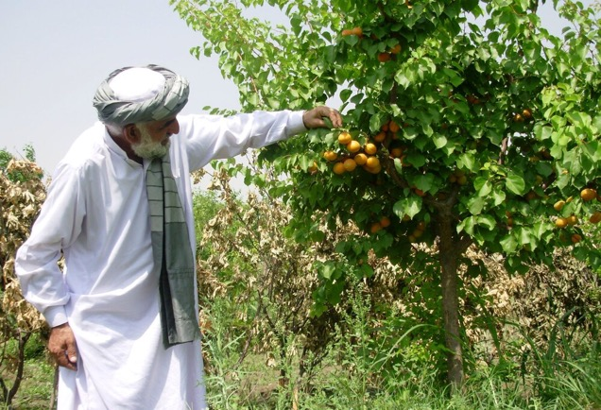
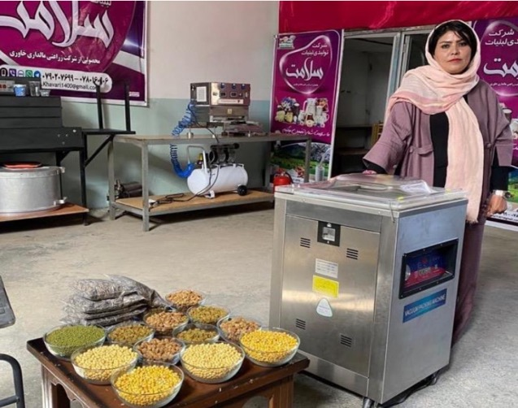
Harvest of hope
Example: Afghanistan impact
Removed 100.000 unexploded bombs and mines from irrigation canals and farmland
1000 hectares of vineyards
220.000 farmers trained in horticultural skills and business management
Notes:
Harvest of hope
Heidi Kühn’s greatest goal through Roots of Peace is to empower farmers to feed their families and yield a “harvest of hope.”
"We aren't just turning mines into vines," Heidi said. "We are providing a business model for peace. Peace is the hardest aspiration, but it's also the most rewarding. We cannot give up."
As an example the impact Roots of Peace has on Afghanistan:
100.000 unexploded bombs and mines are removed from irrigation canals and farmland.
This results in 1000 hectares of vineyards.
220.000 farmers are trained in horticultural skills and business management,

Slide 12


Slide 13


