Slide 1

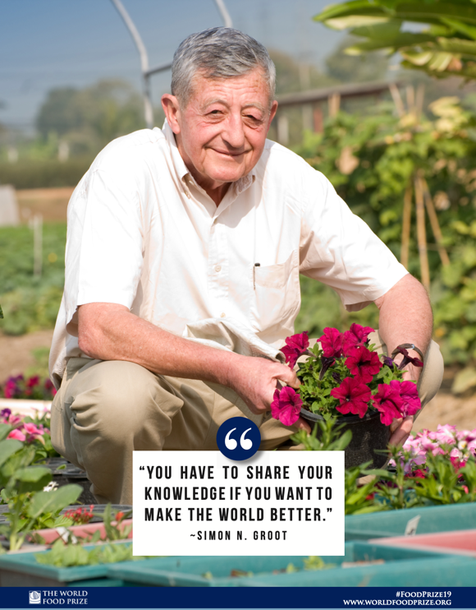
Laureate lessons
2019: Simon Groot
Improving and developing the vegetable seed industry in tropical countries to bring higher quality seeds to smallholder farmers.
©Greetje Kranenburg, Stimuleer - in cooperation with Wageningen Youth Institute

Slide 2


Slide 3
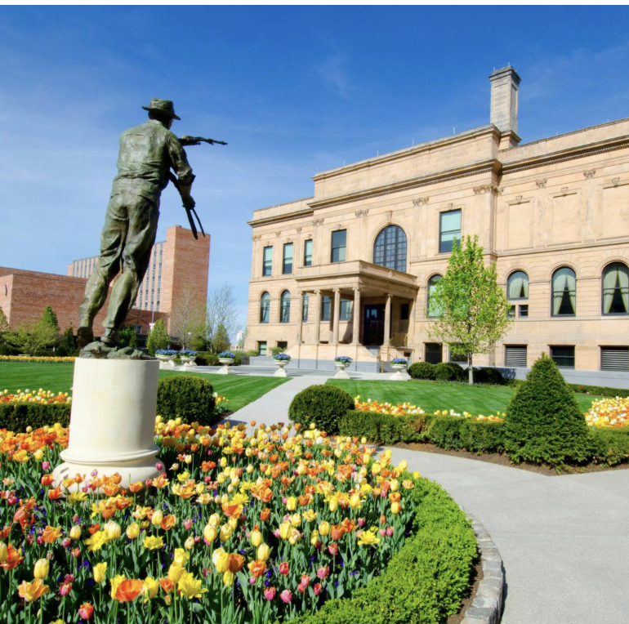

What is the World Food Prize?
International award recognizing individuals who have advanced human development by improving the quality, quantity, or availability of food in the world
“Nobel Prize for food and agriculture”
Founded in 1986 by Dr. Norman E. Borlaug, recipient of the 1970 Nobel Peace Prize
Notes:
The World Food Prize (slide 3)
The World Food Prize is the foremost international award recognizing the achievements of individuals who have advanced human development by improving the quality, quantity or availability of food in the world. The Prize was founded in 1986 by Dr. Norman E. Borlaug, recipient of the 1970 Nobel Peace Prize. Since then, the World Food Prize has honored more than 50 outstanding individuals who have made vital contributions throughout the world. The World Food Prize annually hosts the Borlaug Dialogue international symposium and a variety of youth education programs to help further the discussion on cutting-edge global food security issues and inspire the next generation to end hunger.

Slide 4
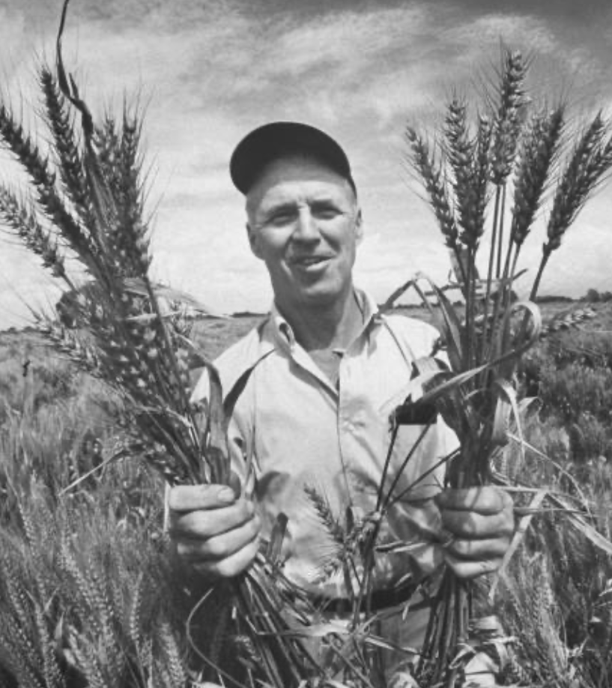
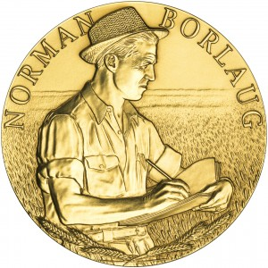
Norman Borlaug
American agricultural scientist
“Father” of the Green Revolution
Introduction of new varieties of crops with higher yields and less diseases
Impact: significant reduction in world hunger
1970: Nobel Peace Prize
Notes:
The World Food Prize (slide 3)
The World Food Prize is the foremost international award recognizing the achievements of individuals who have advanced human development by improving the quality, quantity or availability of food in the world. The Prize was founded in 1986 by Dr. Norman E. Borlaug, recipient of the 1970 Nobel Peace Prize. Since then, the World Food Prize has honored more than 50 outstanding individuals who have made vital contributions throughout the world. The World Food Prize annually hosts the Borlaug Dialogue international symposium and a variety of youth education programs to help further the discussion on cutting-edge global food security issues and inspire the next generation to end hunger.

Slide 5
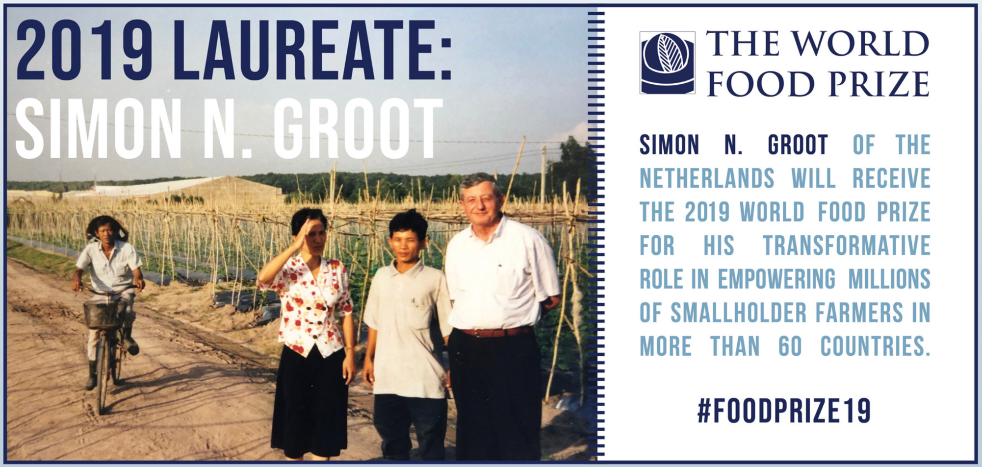

Slide 6
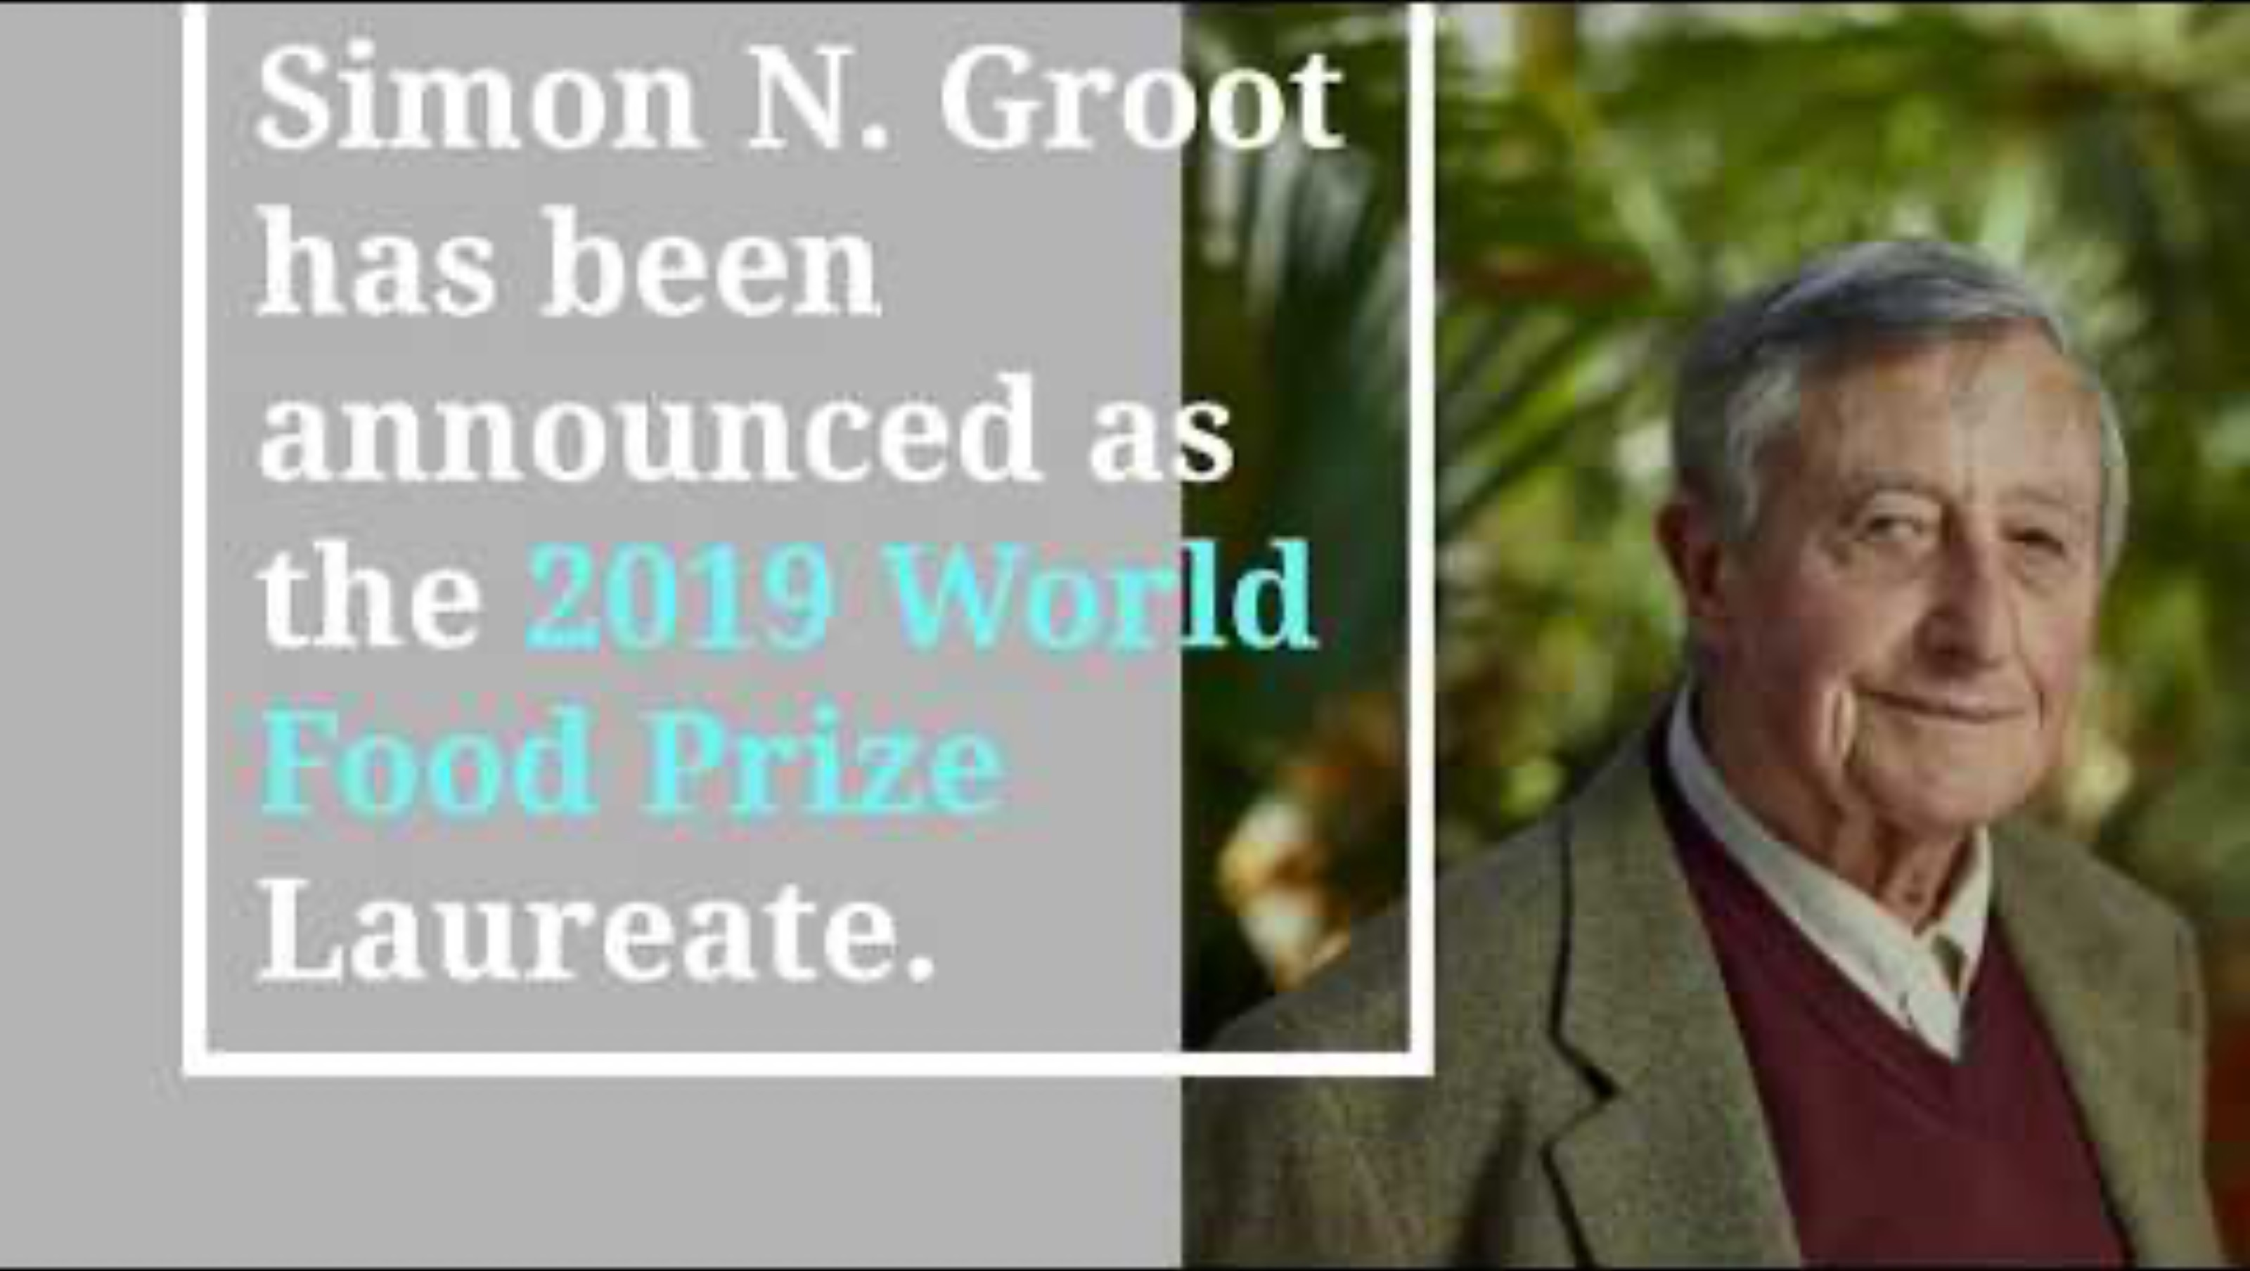

Slide 7
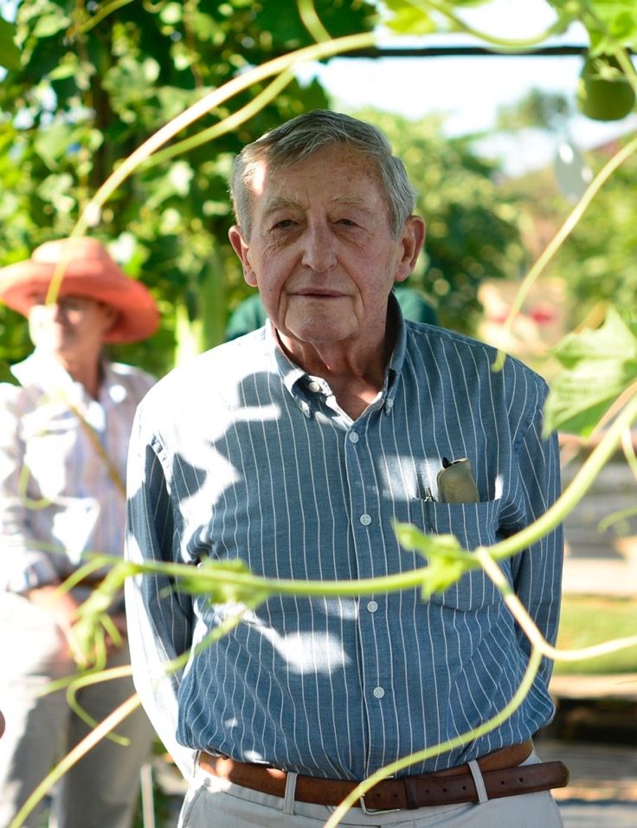
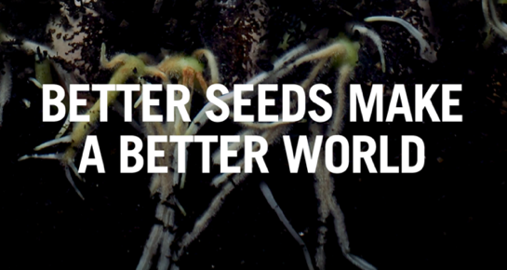
Grounds for WFP Simon Groot
Transformative role in empowering millions of smallholder farmers in more than 60 countries to earn greater incomes through enhanced vegetable production, benefiting hundreds of millions of consumers with greater access to nutritious vegetables for healthy diets.

Slide 8
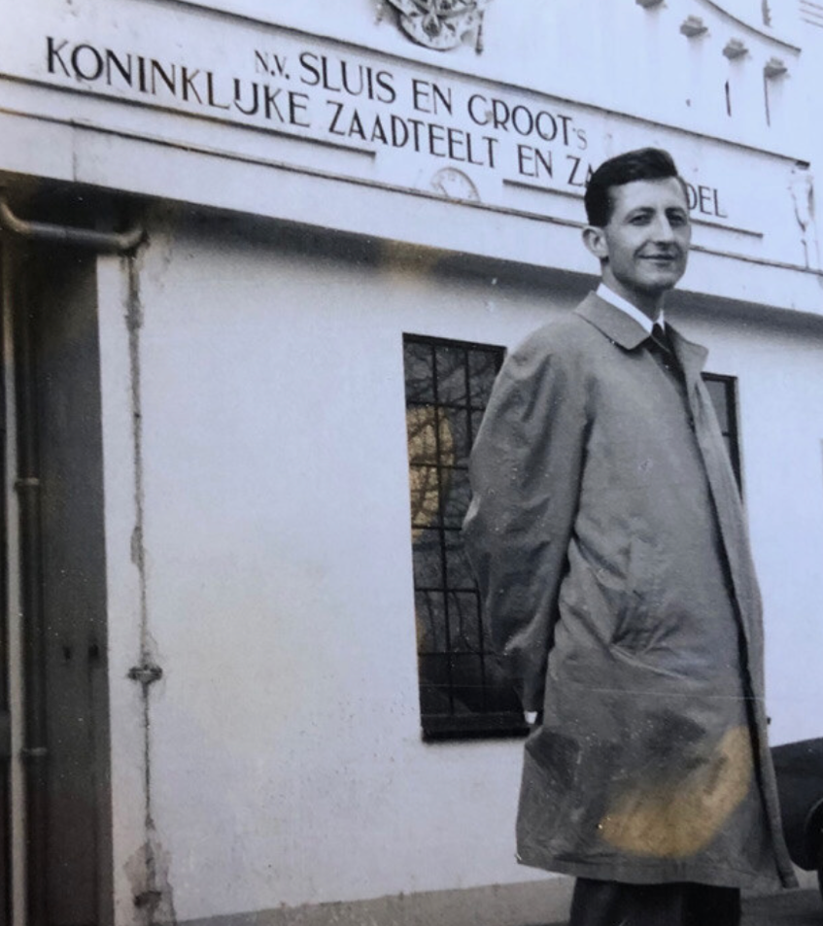
Life and career of Simon Groot
Born in 1934
Degree in business economics
1958: starts working at the family business Sluis & Groot, a Dutch seed company
1965: first business trip to Indonesia
  first introduction to the issues of smallholder farmers in Asia
1982: founding of East-West Seed Company
Notes:
Life and career of Simon Groot (slide 7)
Simon Groot was born in 1934 in Enkhuizen, a small Dutch town known for its world-class seed companies. Enkhuizen gained this distinction in no small part due to the activities of Groot’s own ancestors, who had been in the seed business for five generations.
After graduating from Erasmus University Rotterdam with a degree in business economics and serving two years as an officer in the Royal Dutch Army, Groot entered the family business Sluis & Groot in 1958 at his father’s urging.
One of his first assignments upon starting at Sluis & Groot was a traineeship with Chicago-based Vaughan’s Seed Company, where he would learn more about the U.S. seed industry and practice his English.

Slide 9
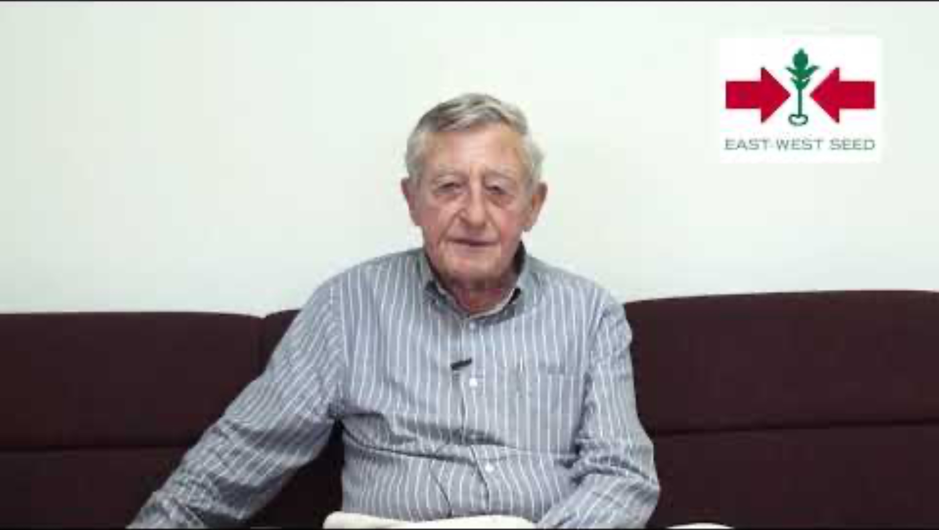

Slide 10
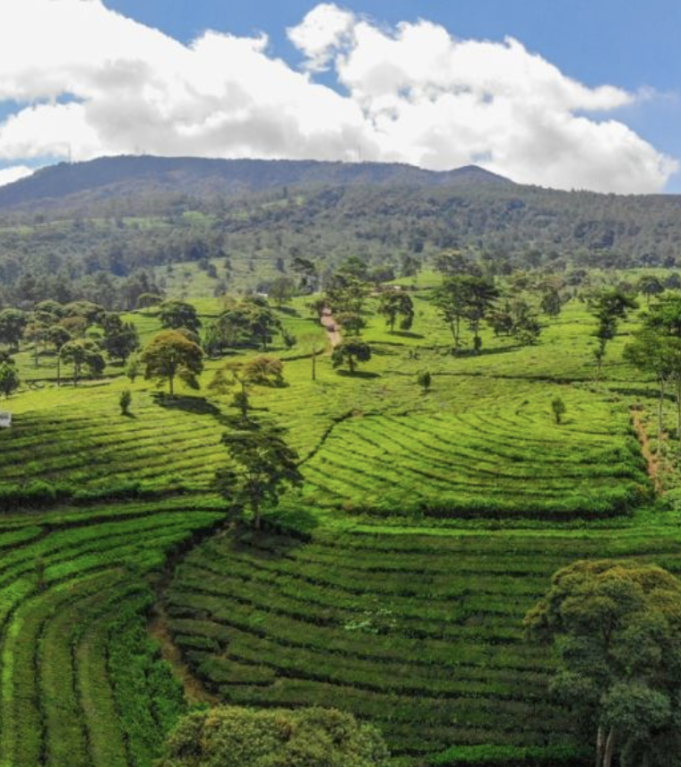
The revelation that started it all…
1965 , highlands Jakarta
Field planted with cabbages of a variety that Sluis & Groot bred and distributed.
In Europe this variety grew well and uniformly
In Indonesia it was producing fewer heads, many of them misshapen.
Notes:
The revelation that started it all…
In 1965, Groot went on his first business trip to Indonesia to arrange flower seed production for Sluis & Groot. There in the highlands above Jakarta, he discovered a field planted with cabbages of a variety that his own company bred and distributed. Though this variety grew well and uniformly throughout Europe, in Indonesia it was producing fewer heads, many of them misshapen. The variety which had been bred to thrive in a temperate climate had fizzled in the tropics. The thought struck him that here was a huge opportunity to introduce hybrid cabbage to the tropics. This idea would stick with him for sixteen years until he would finally find himself in a position to do something about it and transform the lives of millions of farmers in the process.

Slide 11

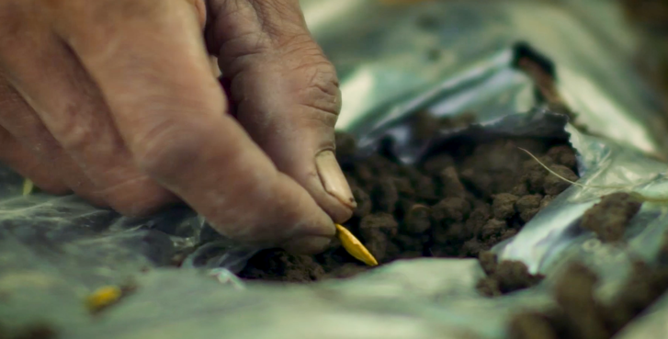
East meets west
1982, Philippines
Idea: good vegetable seeds can change the life of the poor
Goal: market-oriented vegetable seeds breeding company with smallholders as the main client base
To show partnership between an Asian and a European, they named the firm East-West Seed Company.
Notes:
East meets West
Simon Groot founded East-West Seed Company in 1982 in the Philippines with the idea that a good vegetable seed could change the lives of the poor. Having observed the many challenges facing poverty-stricken smallholder farmers in Southeast Asia, Groot set out to establish the first market-oriented vegetable seeds breeding company with smallholders as the main client base.
After years of dedicated research and development with business partner Benito Domingo, Simon Groot introduced the first locally developed commercial vegetable hybrids in tropical Asia. These varieties were fast-growing, high-yielding and resistant to local diseases and stresses. Simon Groot also realized that in order for farmers to maximize the value of these high-quality seeds, they needed training on improved vegetable cultivation.

Slide 12
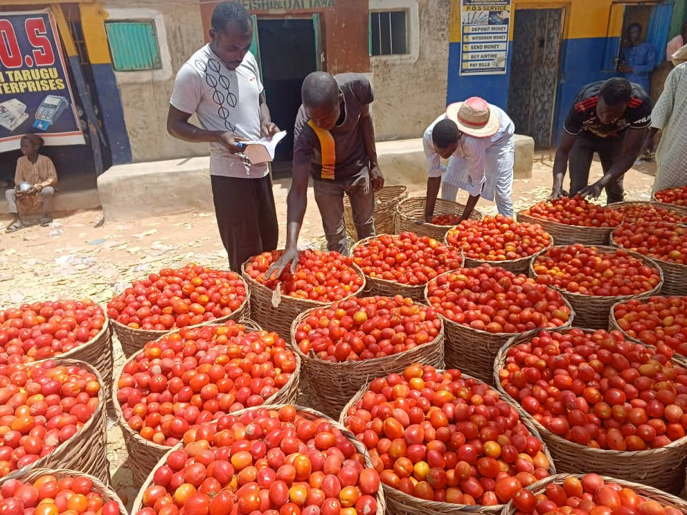
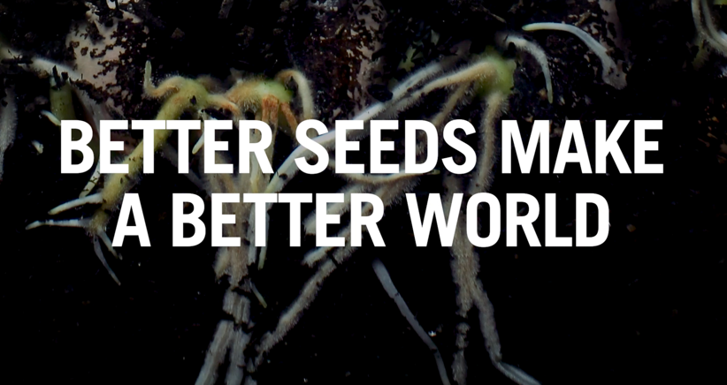
East-West Seed Company
Mission: to bring quality seeds to smallholders.
Commercial vegetable breeding was unknown in the tropics
Start: five-hectare farm in Batangas
Training local people as breeders and technicians
Cooperation with plant breeders from Wageningen University in the Netherlands
Notes:
East-West Seed Company
When Simon Groot started East-West Seed, commercial vegetable breeding was all but unknown in the tropics. Smallholder farmers struggled to grow a good crop with low-quality, poorly adapted seed that they often saved from season to season. Low-quality seed resulted in low yields, which translated into poverty and malnutrition for farmers and their families. Groot sympathized with the farmers’ plight and saw a way to break the vicious cycle of poverty and help farmers achieve prosperity through diversification into high value vegetable crops.
It started small, with a five- hectare farm outside Lipa City, Batangas, to begin initial plant breeding activities and train local people as breeders and technicians. Rather than import seeds, Groot enlisted well-trained plant breeders from Wageningen Agricultural University in the Netherlands to jump-start the breeding process and help train locals. This association with Wageningen was among the first of the many public-private partnerships that Groot would cultivate through the years to aid his mission to bring quality seeds to smallholders.

Slide 13
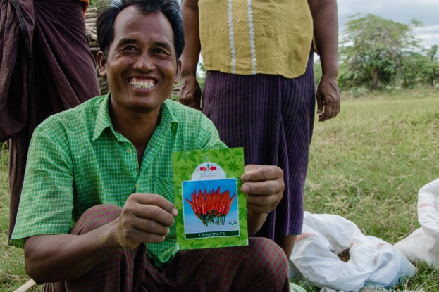
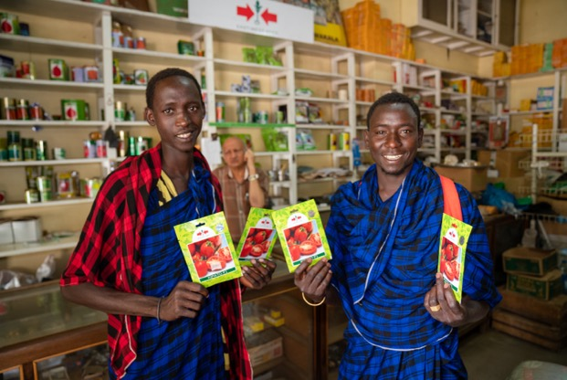
East-West Seed today
Specialized in tropical vegetable varieties
20 million smallholder farmers in more than 60 tropical countries in Asia, Africa and Latin America.
Transition of millions of farmers, many of them women, to horticulture entrepreneurs.
Nutritious vegetables are more widely available and affordable for millions of families each year.
Notes:
East-West Seed today
East-West Seed serves over 20 million smallholder farmers in more than 60 tropical countries in Asia, Africa and Latin America. Groot has led the transition of millions of subsistence farmers, many of them women, to horticulture entrepreneurs, thereby greatly enhancing their livelihoods and income. These farmers have invigorated both rural and urban markets for vegetable crops in their communities, making nutritious vegetables more widely available and affordable for millions of families each year.

Slide 14
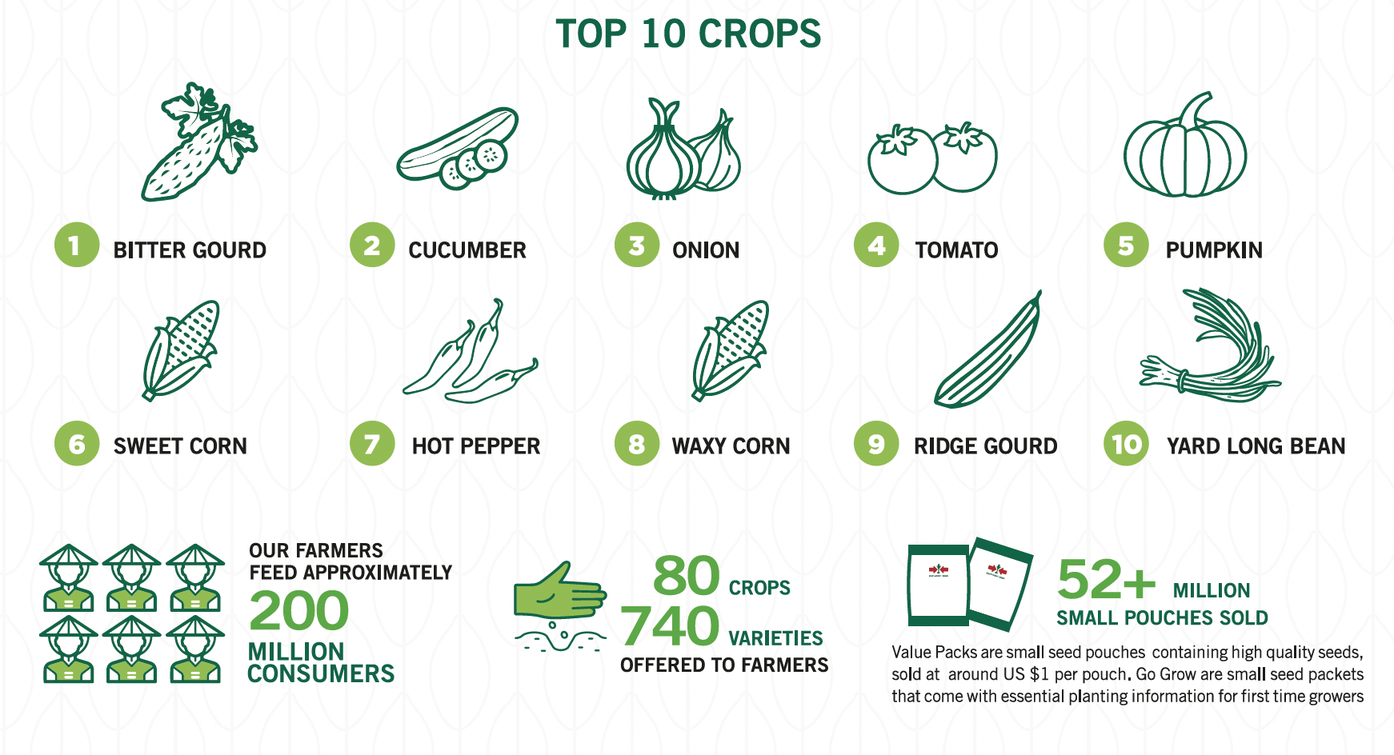
Notes:
Timeline of development of improved vegetable varieties by East-West Seed Company since 1986

Slide 15
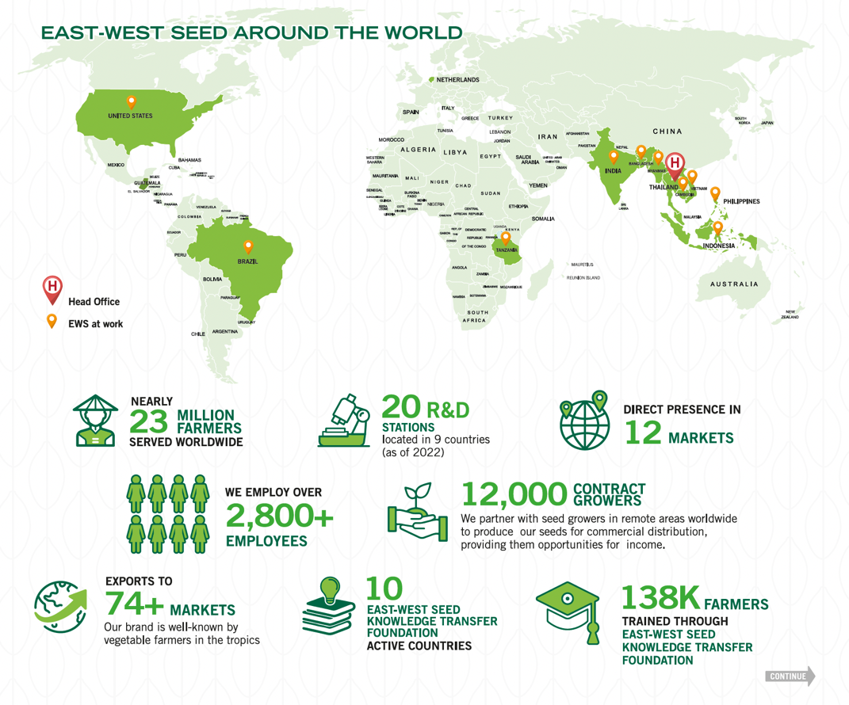
Notes:
Timeline of development of improved vegetable varieties by East-West Seed Company since 1986

Slide 16
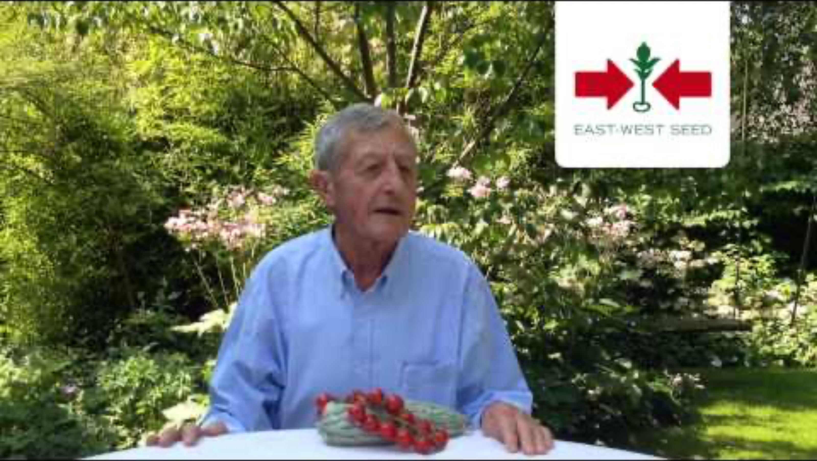

Slide 17

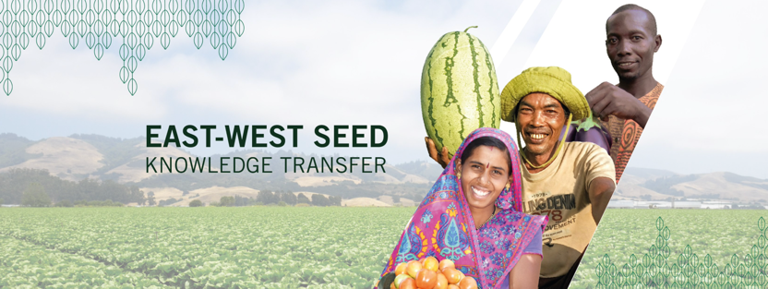
Knowledge Transfer program
Innovative program
Tens of thousands of farmers are trained in good agricultural practices for vegetable production.
Result:
  better seeds and farming methods
  Dramatic increase in farmers profits
  Greater availability of nutritious vegetables in local markets.
Notes:
Knowledge Transfer program
Working closely with local and international NGOs, Groot created East-West Seed’s innovative Knowledge Transfer program, which trains tens of thousands of farmers each year in good agricultural practices for vegetable production. As a result of better seeds and farming methods, farmers saw a dramatic increase in their profits, doubling or even tripling their incomes, and consumers found greater availability of these nutritious vegetables in their local markets.

Slide 18
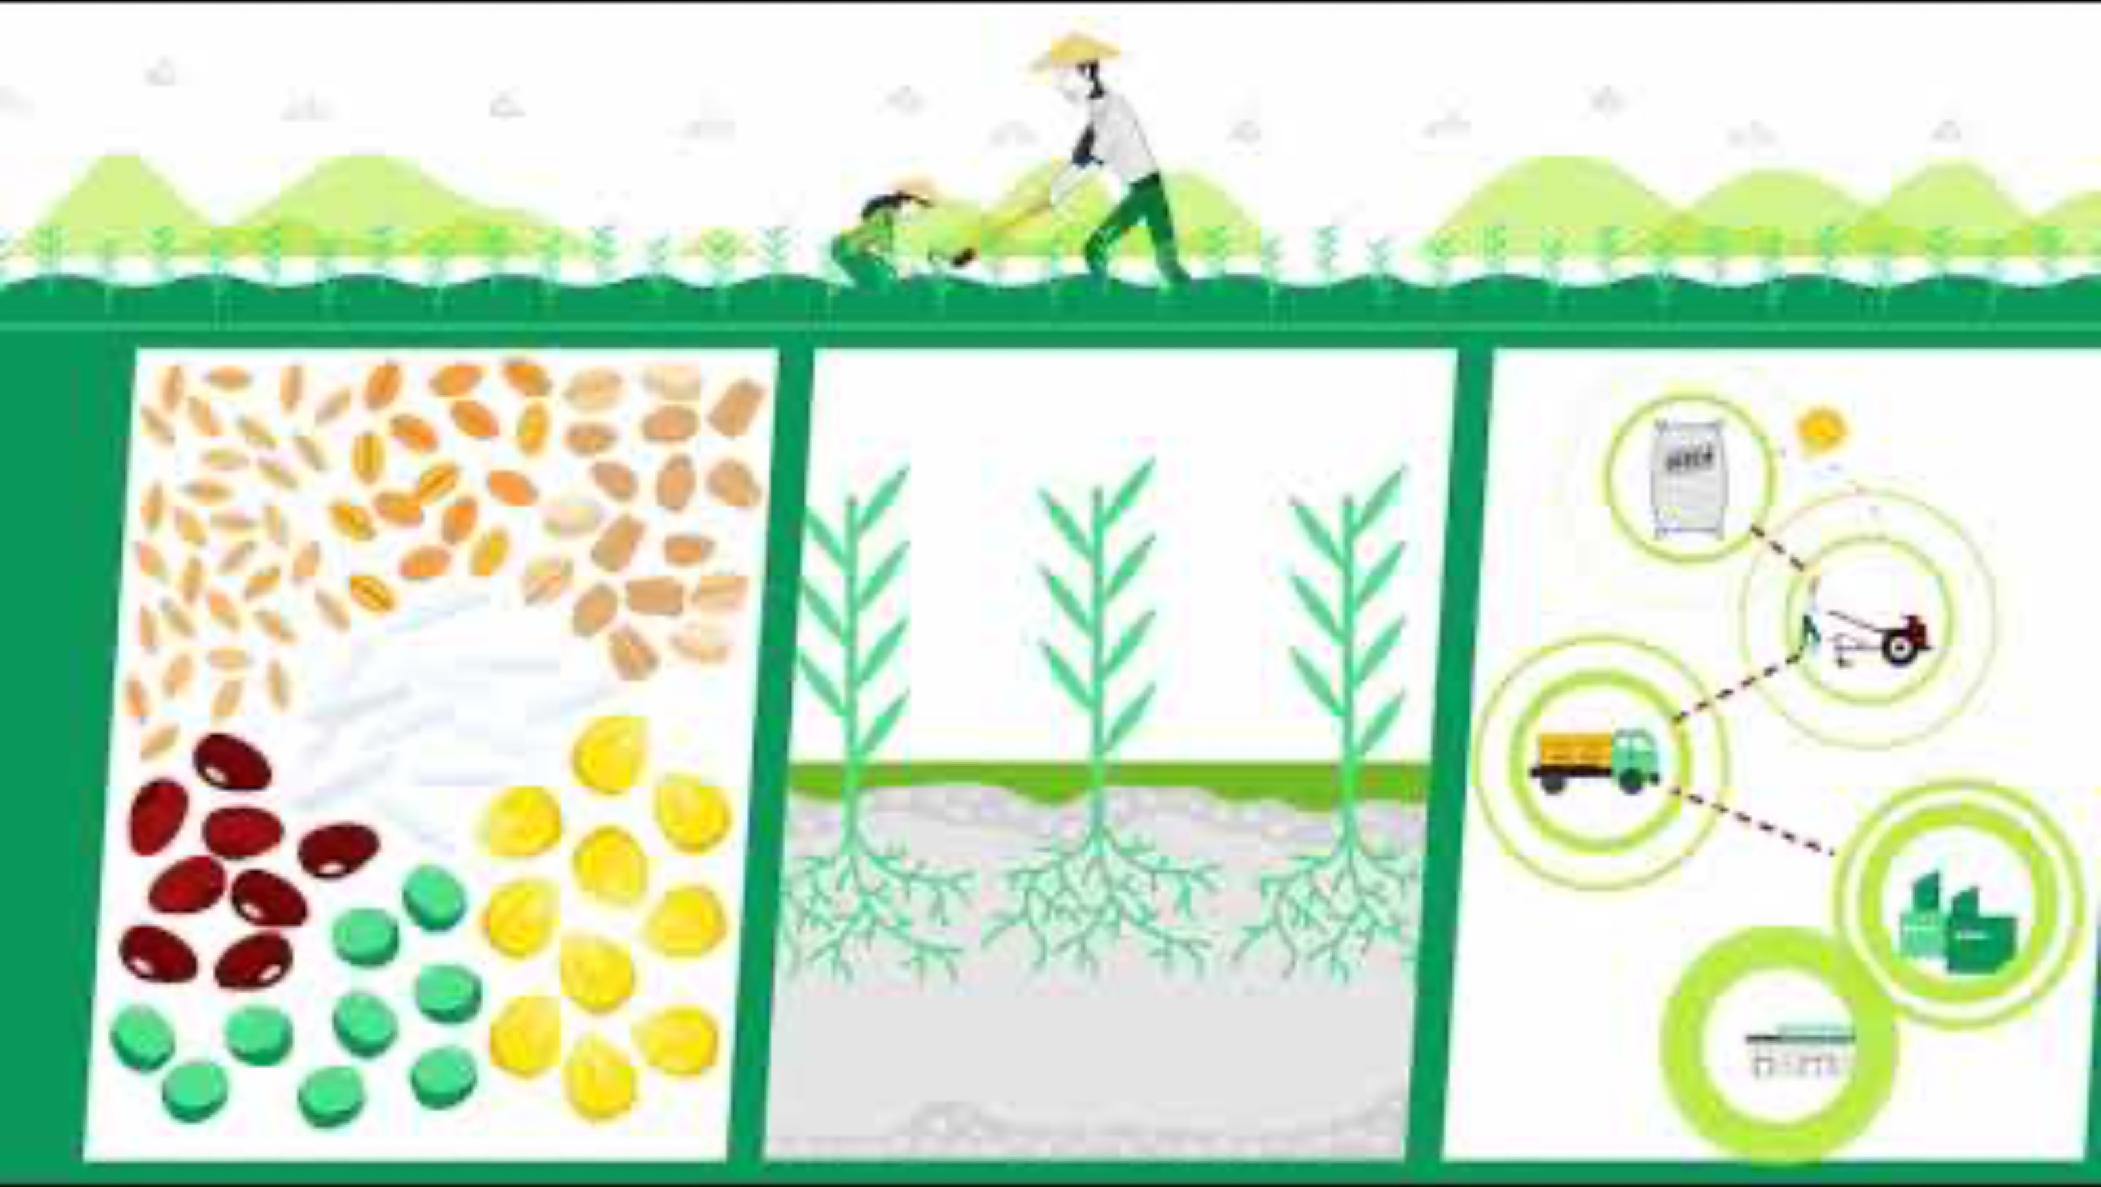

Slide 19


Slide 20
